Slide 1
Airline Passenger Satisfaction
Name: Sayeda Sanzida Ferdous Ruhi
ID: CSE 072 08182

Slide 2
Airline Passenger Satisfaction
Encompasses the overall contentment and fulfillment of passengers.
Multifaceted concept.
Often measured through surveys and feedback mechanisms.

Slide 3
Dataset Description
Total contains 24 attributes
Total rows 129880
Target attribute is ‘satisfaction’

Slide 4
Exploratory Data Analysis
Histogram
Scatterplots
Co-related Variables
Box-plot

Slide 5
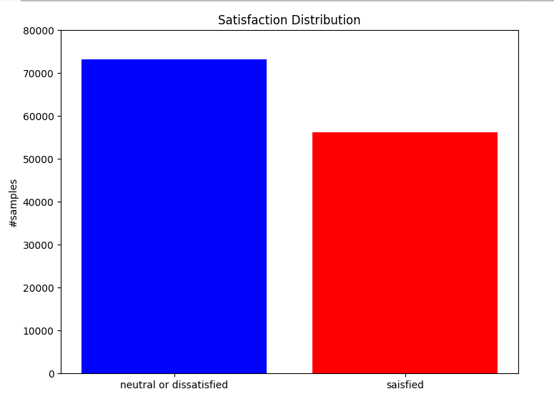
Histogram

Slide 6
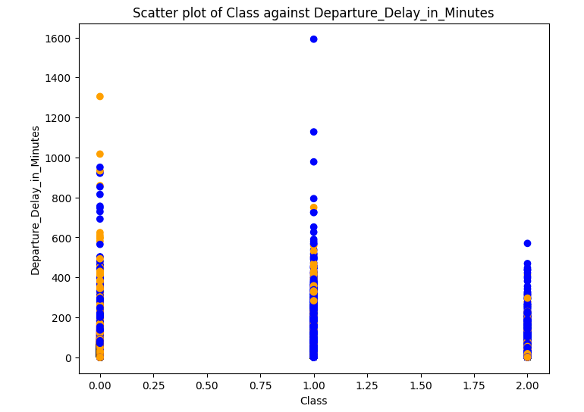
Scatterplots

Slide 7
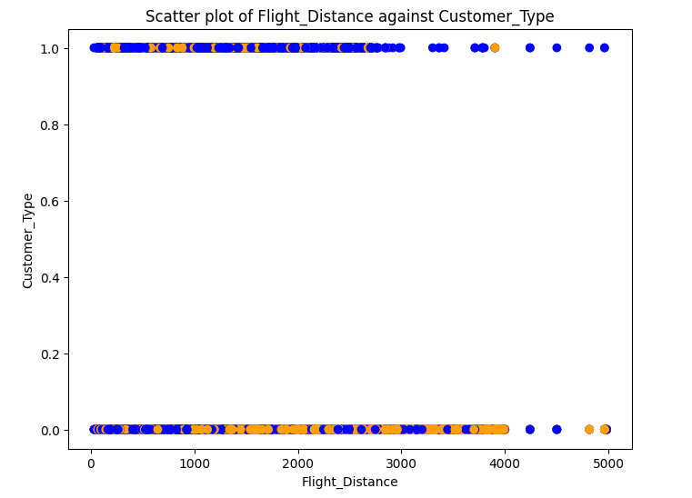
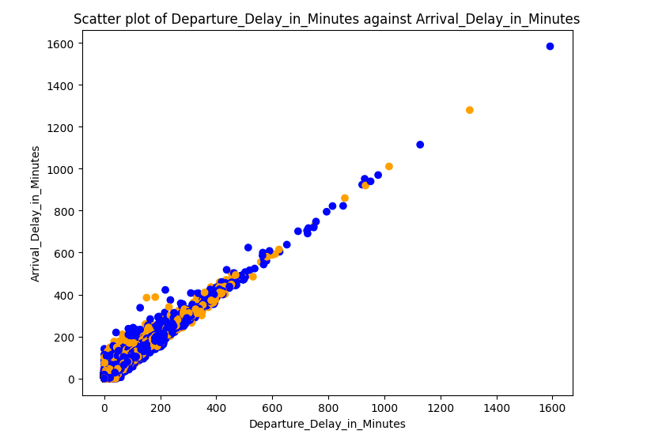

Slide 8
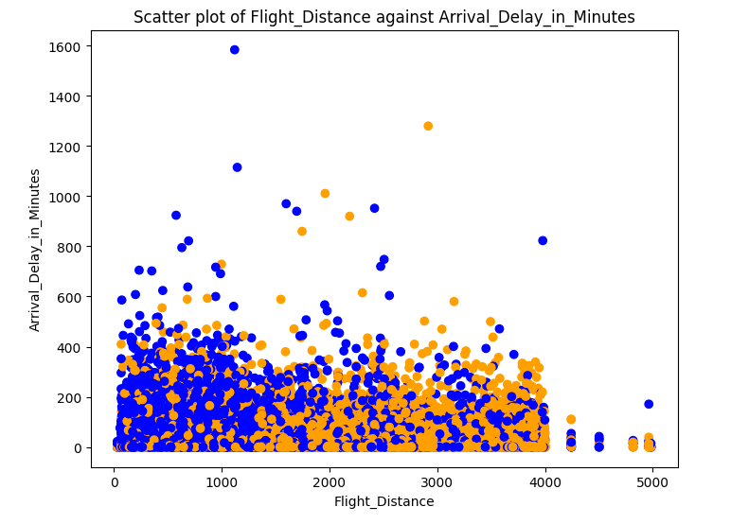

Slide 9
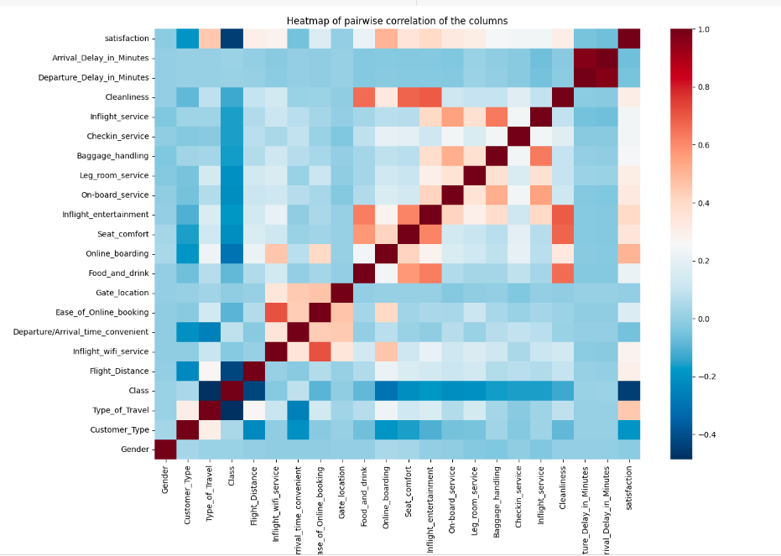
Co-related Variables

Slide 10
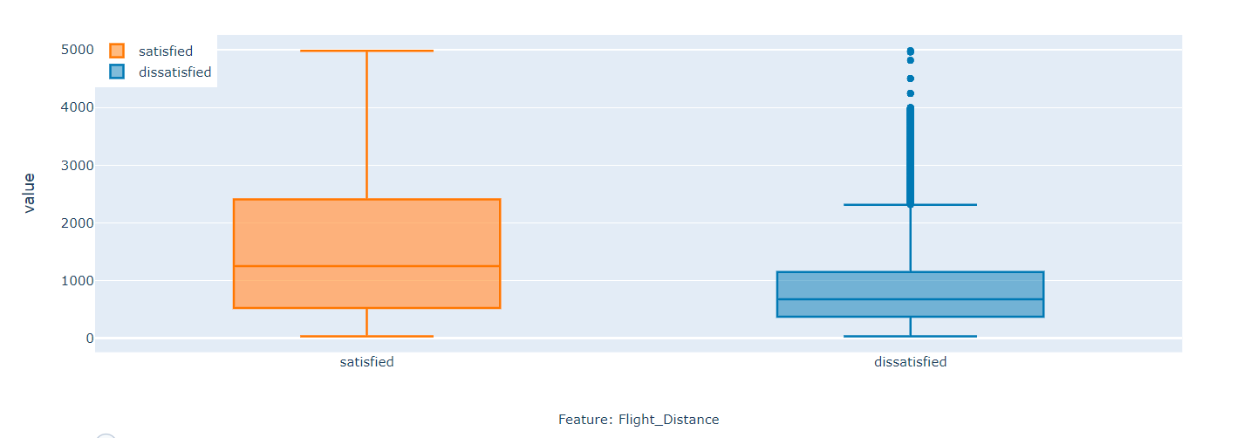
Box-plot

Slide 11
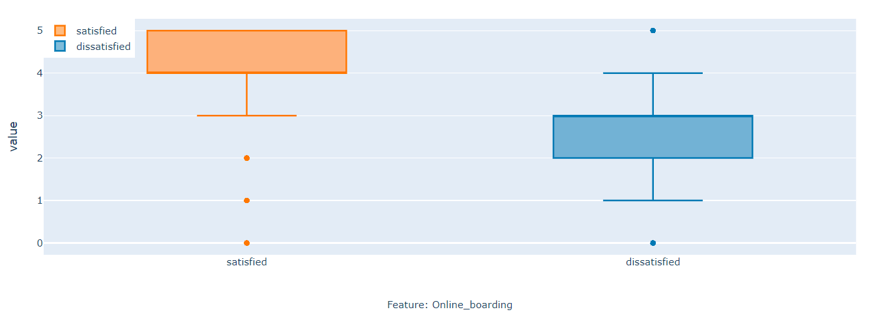
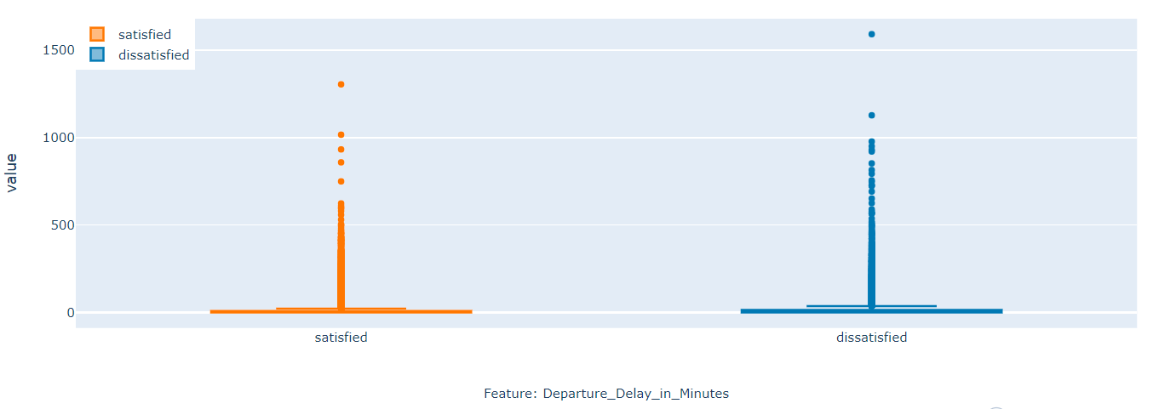

Slide 12
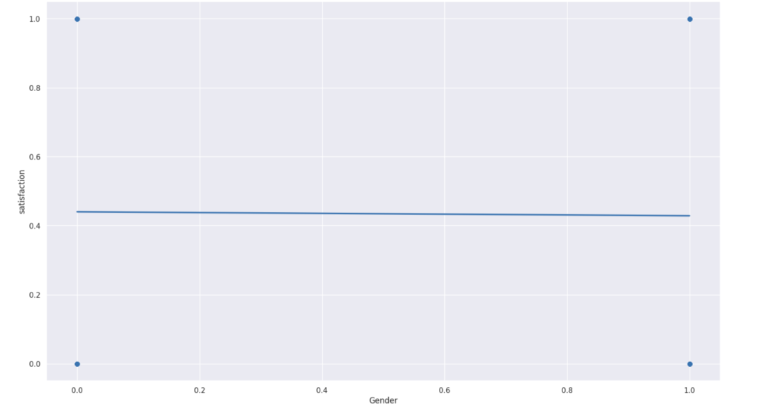
Confidence Measures=95%
Regression

Slide 13
Model Building
Decision Tree
CART Algorithm
C4.5 Algorithm
K-Nearest Neighbor
Neural Network
Hierarchical & K-Means Clustering
Hierarchical Clustering
K-Means Clustering

Slide 14
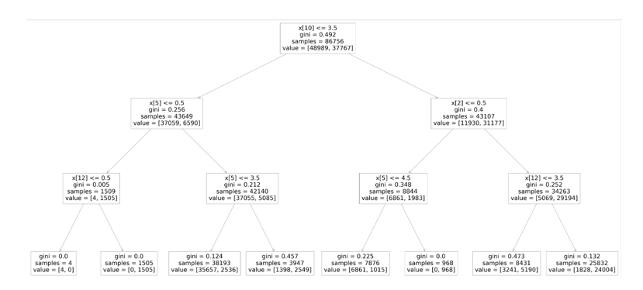
CART Algorithm

Slide 15
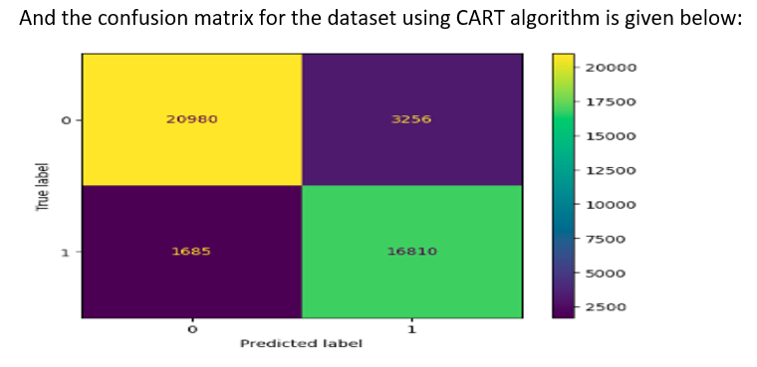
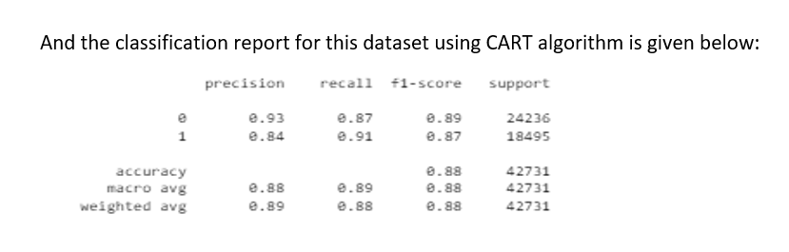

Slide 16
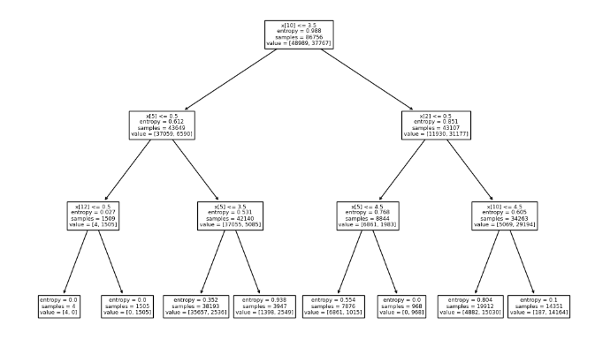
C4.5 Algorithm

Slide 17
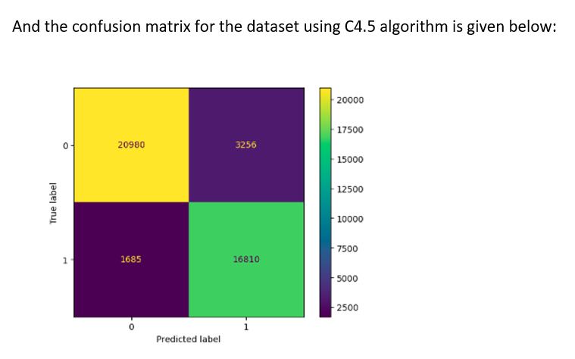
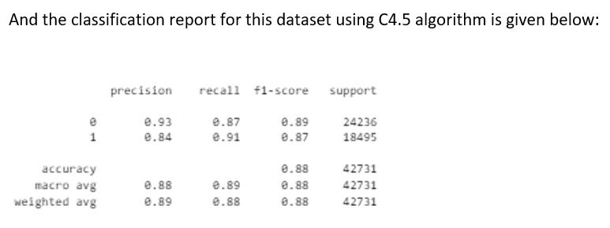

Slide 18
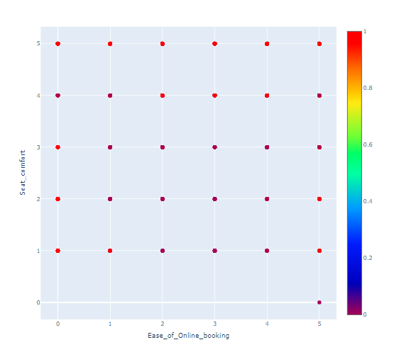
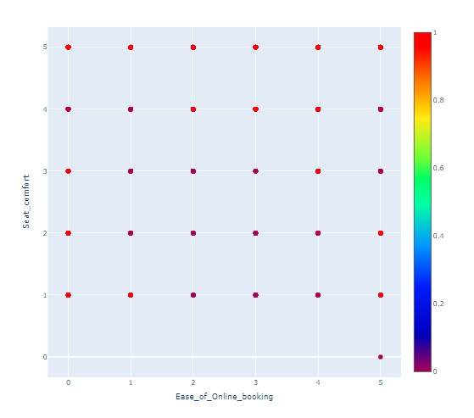
K-Nearest Neighbor

Slide 19
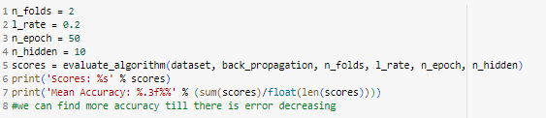

Neural Network

Slide 20
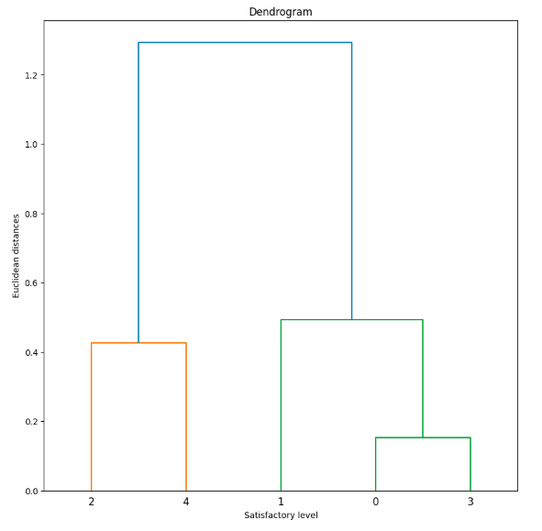
Hierarchical Clustering

Slide 21
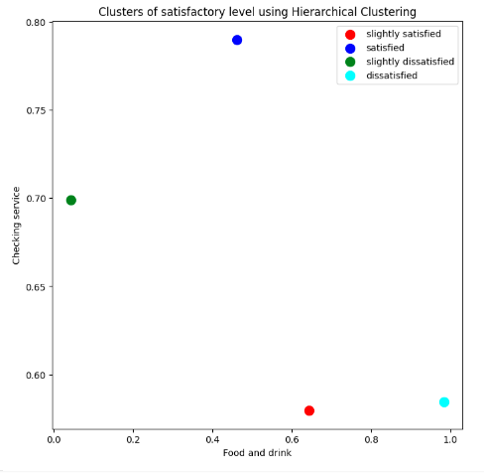
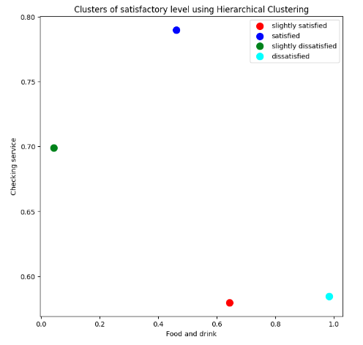
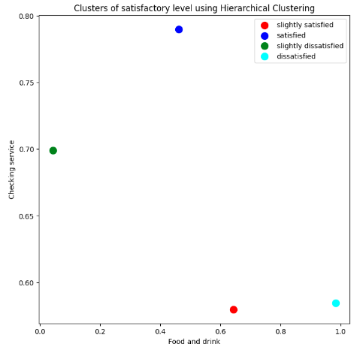
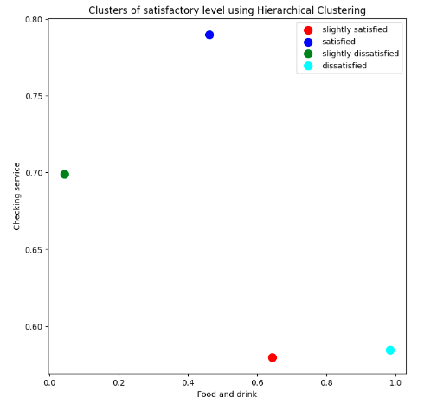
Single
Complete
Average
Ward

Slide 22
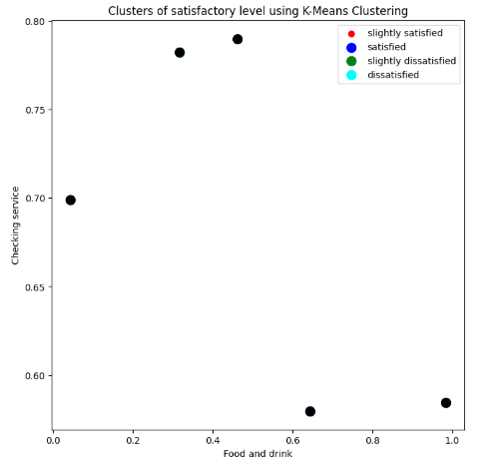
K-Means Clustering

Slide 23
Model Evaluation
Radial Svm
Decision Tree
Random forest
Logistic Regression
Naive Bayes
Linear Svm
KNN

Slide 24
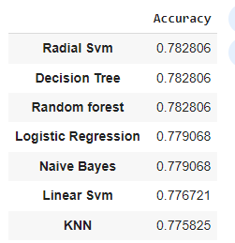
Accuracy:

Slide 25
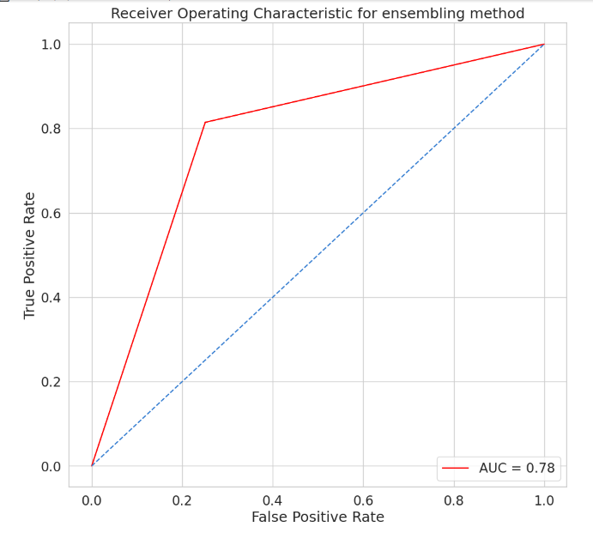
ROC Curve

Slide 26
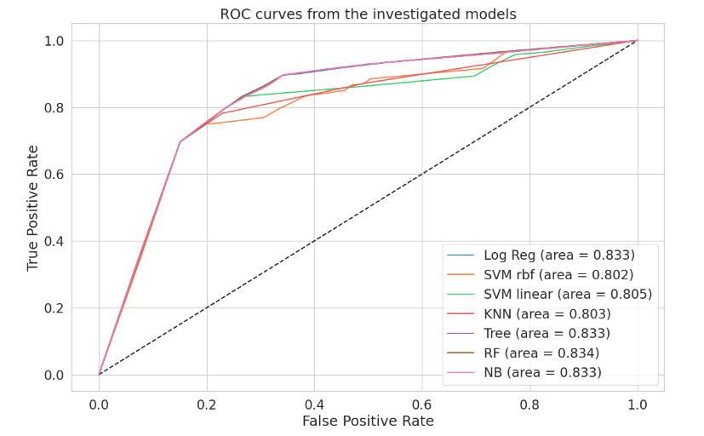

Slide 27
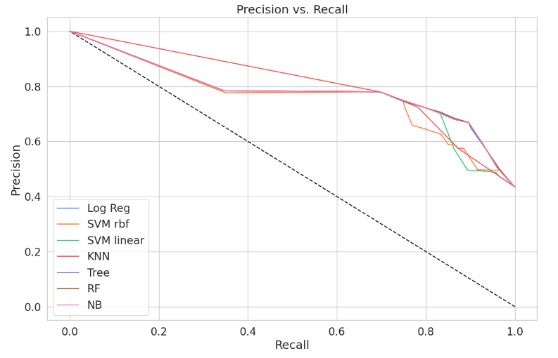
Precision Recall Curve

Slide 28
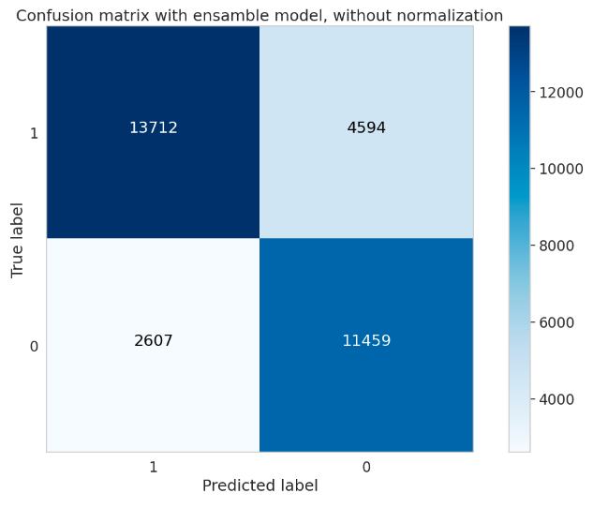
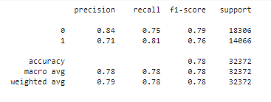
Confusion Matrix
Classification Report

Slide 29
Association Rules
Association rules cannot work properly in this dataset.

Slide 30
Reference:
https://www.kaggle.com/datasets/teejmahal20/airline-passenger-satisfaction

Slide 31


Slide 32


